Slide 1
Cybersec
Blogs & Bombe
BY:
Ramakanth.SVN → 118 Venkateshwarlu Gupta.V → 119

Slide 2
Designed Plan
Login/Signup
Blogs
Contact us to write a blog
Encode
Decode
No limit for accessing Bombe machine

Slide 3
WHAT IS CYBERSECURITY ?
Cyber security is the practice of defending computers, servers, mobile devices, electronic systems, networks, and data from malicious attacks.

Slide 4
NEED FOR CYBERSECURITY
Some cybersecurity experts agree with a report by Cybersecurity Ventures and expect financial damages from cybercrime to reach $6 trillion by the end of this year.

Slide 5
This project has 2 segments in it:
BLOGS
BOMBE

Slide 6
BLOGS
It’s of uttermost priority to stay updated in CS domain. An efficient way to do that is by reading blogs. This project has blogs different categories such as Networking, Security, Cybersecurity Awareness, tools, and
Cutting edge technologies

Slide 7
BOMBE
In order to maintain confidentiality, Integrity and accessibility (CIA Triad) we need good techniques. Encryption and decryption of data using combined cryptography and steganography is one such approach

Slide 8
CRYPTOGRAPHY?
Cryptography is an advanced mathematical approach to generate ciphers and encrypt the data

Slide 9
Steganography?
Steganography is the art of concealing information into transfer media such as images, audio and video files. Here we deal with image steganography

Slide 10
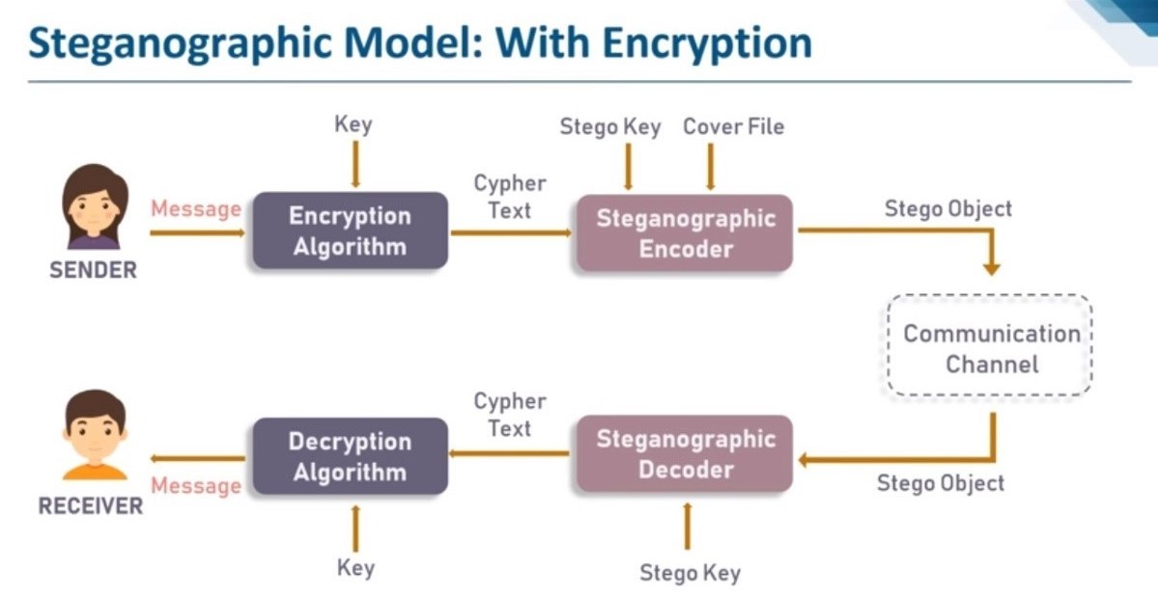

Slide 11
CIPHERS USED: AFFINE CIPHER CEASER CIPHER STEGANOgRAPHy USED: LSB (least significant bit) technique

Slide 12
DONE USING:
HTML5
CSS3
BOOTSTRAP
PYTHON
PILLOW
POSTGRESQL
DJANGO

Slide 13
Django
Python Web-framework
High Scalability
Modularize (apps)
Authentication module
ORM
Offers High Security
Provides Rapid Development

Slide 14
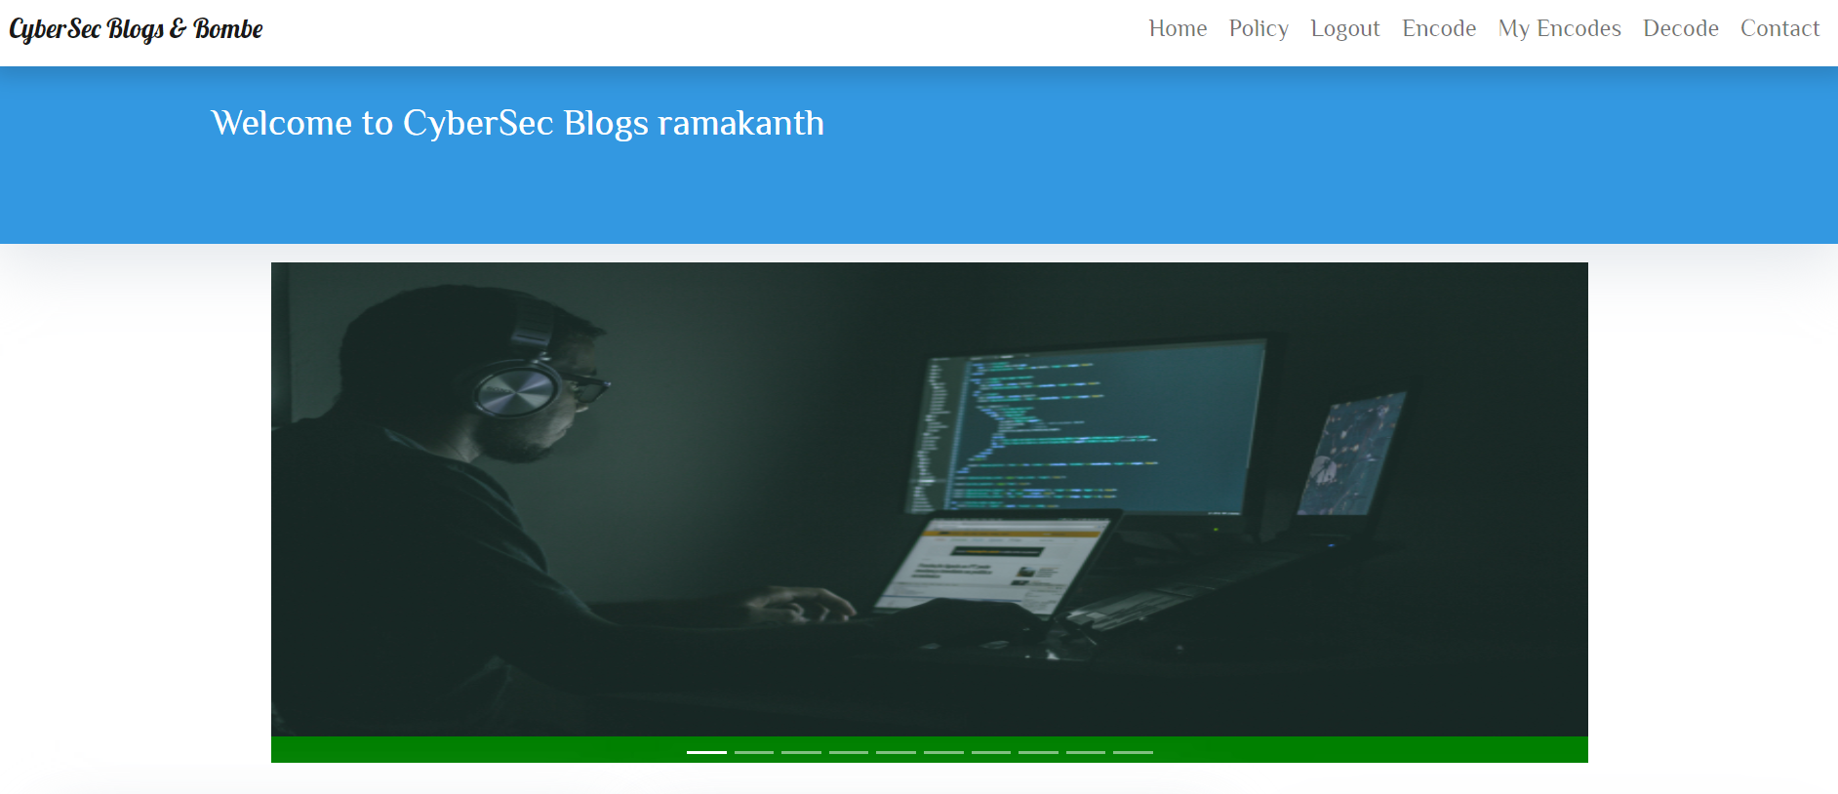
Home page:

Slide 15
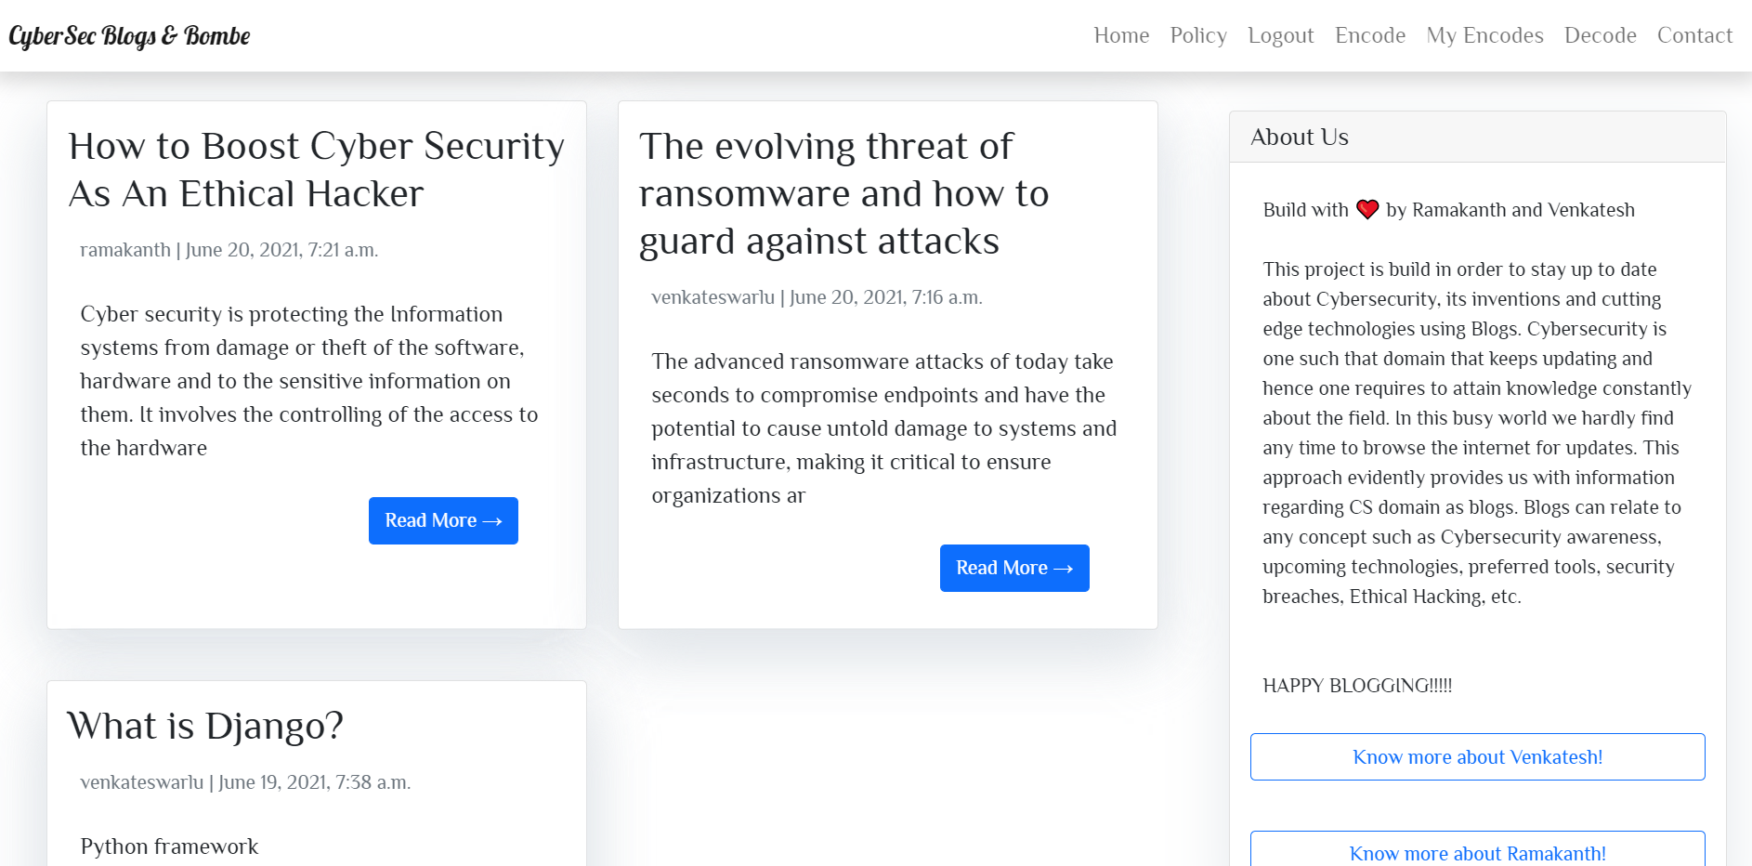
About & Blogs:

Slide 16
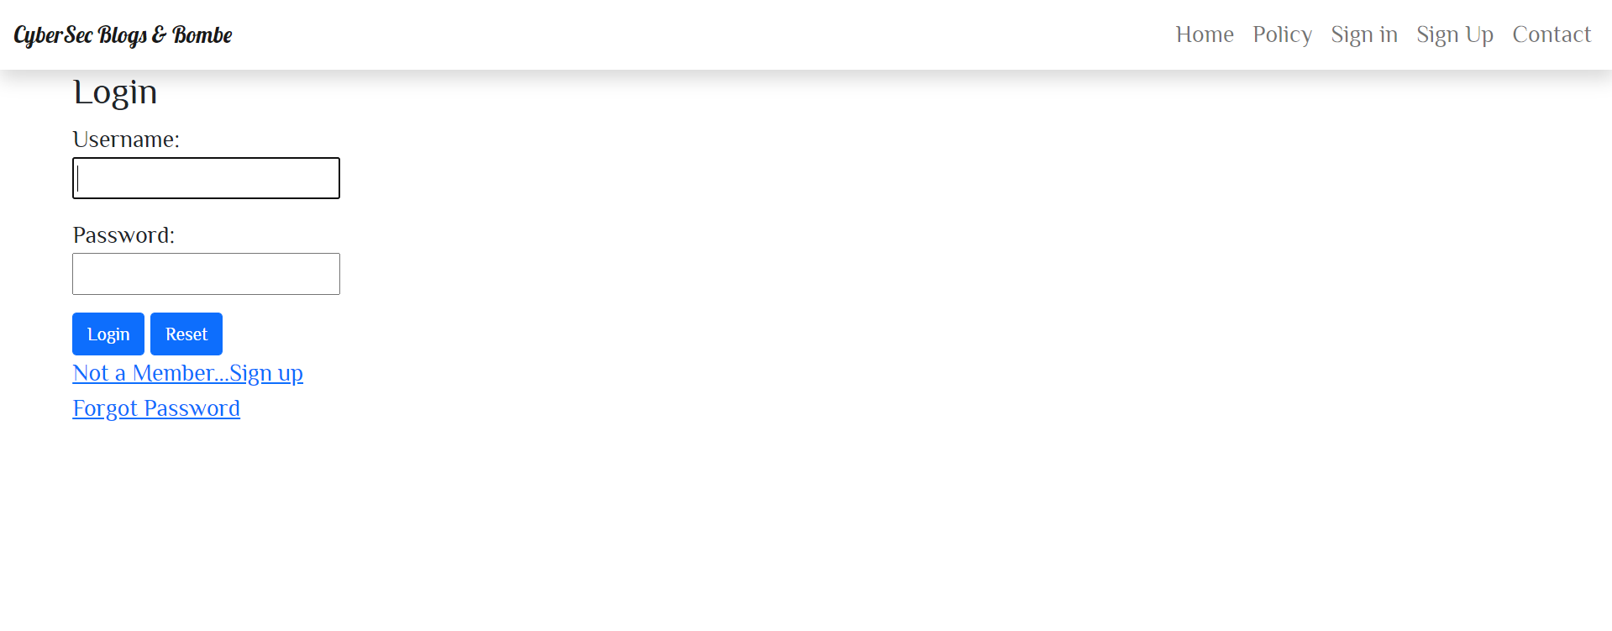
Login page:

Slide 17
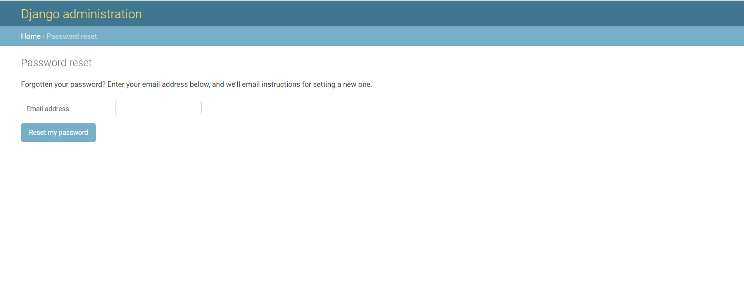
Password Reset:

Slide 18
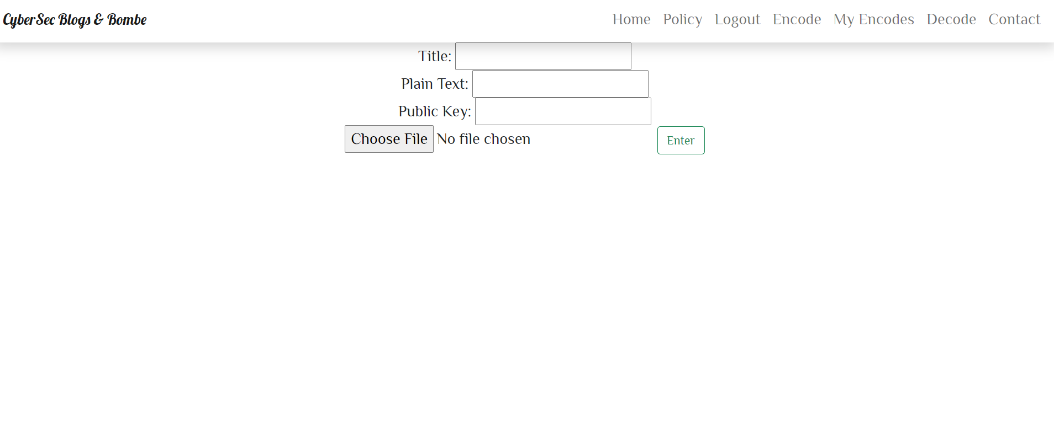
Encoding in Bombe:

Slide 19
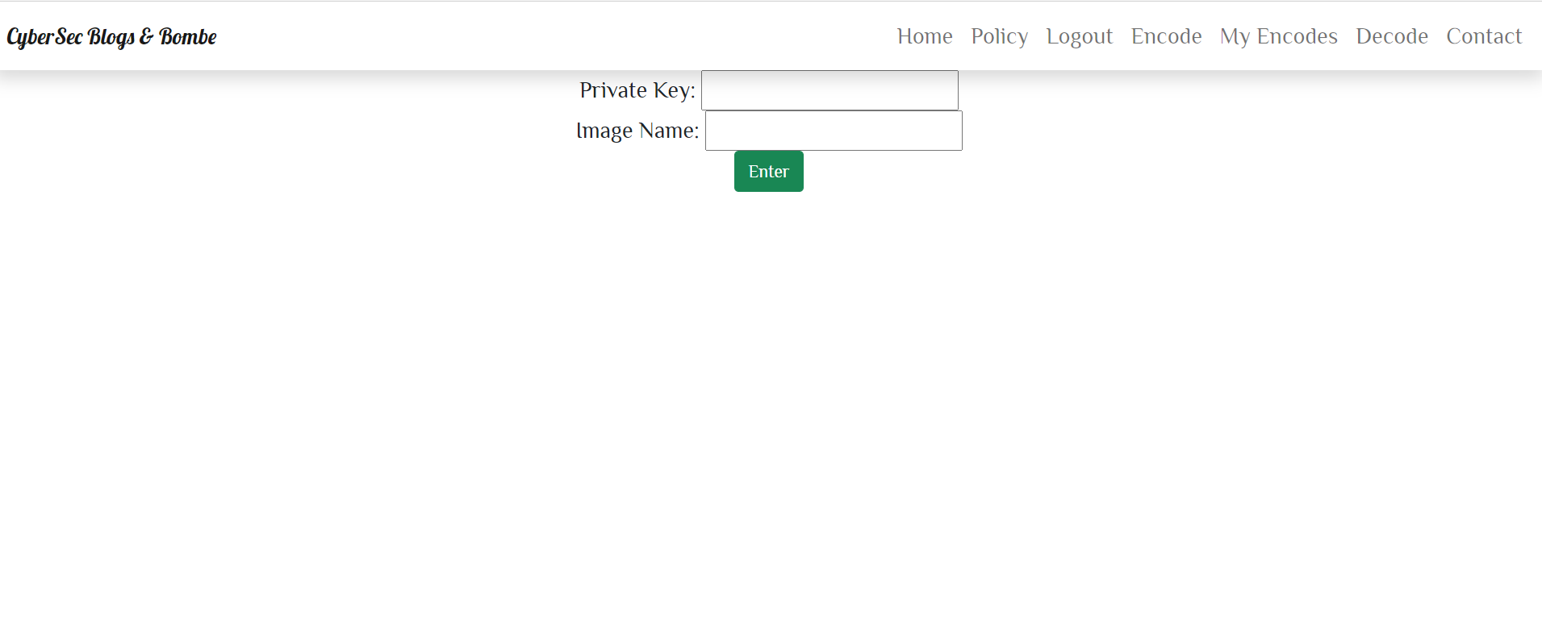
Decoding in Bombe:

Slide 20
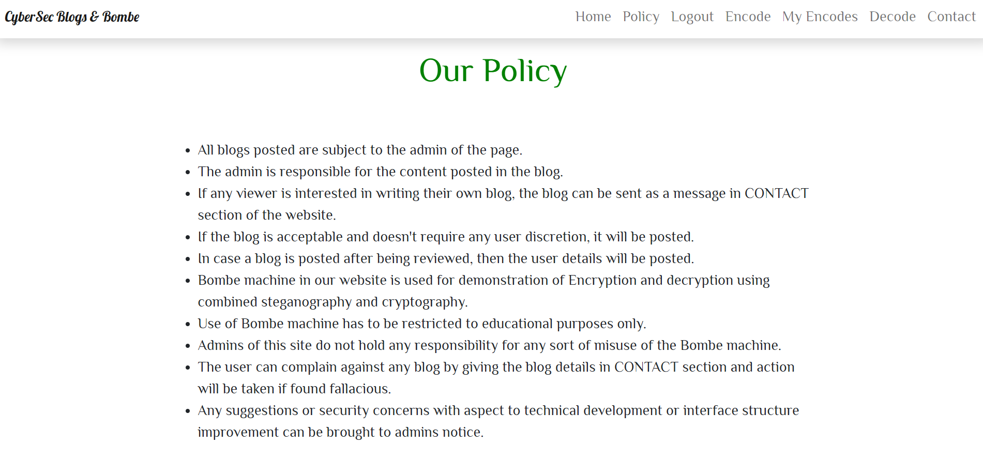
User Policy:

Slide 21
DEMONSTRATION:
- THANKYOU

